Slide 1
Student Behavior Analysis Research of based on Data Mining
Name: M.A.B.Siddique Sanjan
ID: 19201068
Sec: 01
Course: CSE438

Slide 2
Student Behaviour Analysis Research
Utilizing big data and data mining technologies to analyze student behaviour data is key to improving school management. This paper proposes an adaptive K-means clustering algorithm to select student consumption, learning, book borrowing, and access record data for analysis.

Slide 3

Introduction
Smart Campuses
Effective Use of Educational Data
Data-Driven Decision-Making
Universities have constructed smart campuses with information systems that generate a large amount of data. Data is essential for ensuring the sustainable development of university information.
Universities have accumulated a large amount of student data, including consumption, access control, book borrowing, and academic performance. Using data mining technology to analyze and apply this data is crucial for improving school management and talent training.
By analyzing student behaviour data, decision-making support can be provided for college education and teaching and establish a mechanism of data-driven decision-making.

Slide 4
Related Work
1
Data Governance
Data governance is the exercise of rights and control in the process of data asset value creation. It makes university management more intelligent and agile, decision making more scientific, and management more efficient.
2
Machine Learning Clustering Algorithms
Machine learning clustering algorithms are widely used in student behaviour analysis, but traditional algorithms are sensitive to outliers. This paper proposes a K-means clustering algorithm based on the elbow method to improve accuracy.
3
2035 Education Modernization
China's Education Modernization 2035 proposes using big data and data mining to optimize education governance.

Slide 5
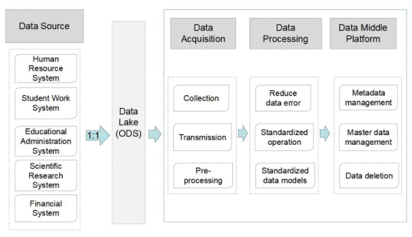
Data Governance Platform Construction
Data Acquisition Layer
Data from various information systems is stored in a physical database, forming a data lake. This method solves cross-database access problems and ensures data security.
Data Governance Layer
The data governance layer processes data from the data lake to form a standardized data warehouse, which serves as the authoritative standard data resource.
Data Application Layer
The data application layer utilizes big data and data visualization technologies to provide diversified data services for teachers and students and boost school governance.
Data Mart Layer
The standardized data warehouse provides various data services through the data mart, such as student and teacher data sets.

Slide 6
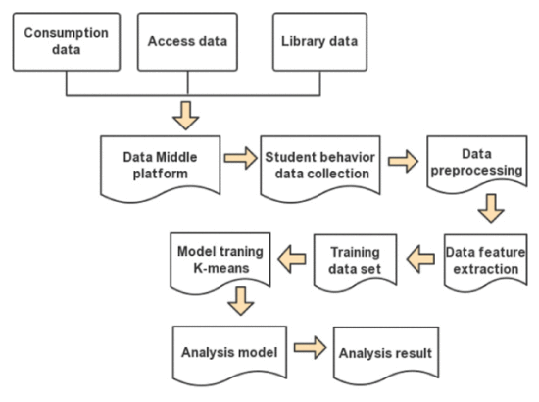
Student Data Feature Modeling
Extracting Student Attributes
Basic Information
Extracting students’ basic information, all-in-one card consumption data, access card records, and library records as feature attributes is essential for predictive analysis.
Normalization
Normalization is used to standardize the data and eliminate data scale differences that can impact the accuracy of the analysis.

Slide 7

Methods of Student Behaviour Analysis
K-Means Clustering Algorithm
We use normalization and K-Means clustering algorithm to analyze the data. The quality of K value selection has a great impact on the analysis results of K-means clustering algorithm. In this paper, K-Means elbow method is used to select K value.
Experiment and Results
The clustering K value is set as 4, and the iteration termination threshold is 0.01. The Euclidean distance is used as the distance between data objects, and the K-Means clustering algorithm is used for analysis. According to the analysis results, students can be divided into four categories according to their consumption level: high, high, medium and low. The results of cluster analysis can be combined with the actual situation of students to help judge the economic situation of students’ families.

Slide 8
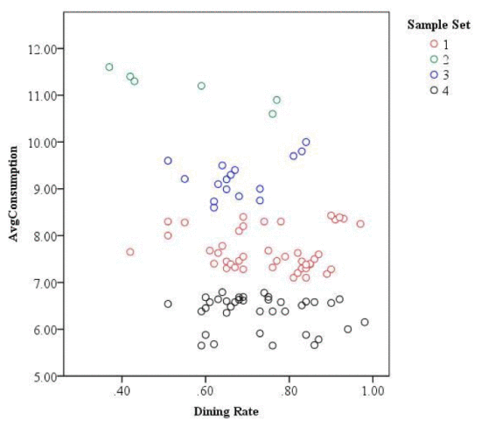
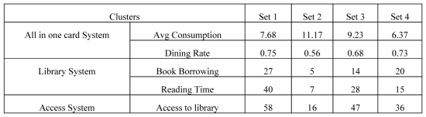
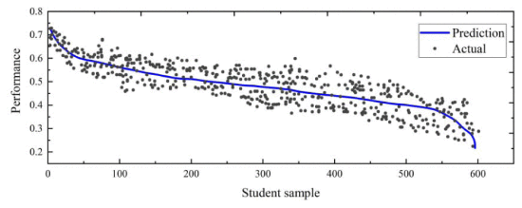
Behavioural Patterns Affecting Performance
Student Behavioural Patterns
1
Regular Eating Habits
Students who consume meals regularly have better academic performance than those who don't.
2
Library Visits
Students who visit the library more often tend to have better academic performance than those who don't.
Learning Habits and Achievements Prediction
Through comprehensive analysis of students’ reading time in the library every month, the number of times in and out of the library, and students’ daily consumption records, students’ learning habits and achievements are predicted.

Slide 9

Conclusion
Data Mining Technology
Data mining technology provides diversified data services for teachers and students and boosts the modernization of school governance.
Data Governance for Modernization
Promoting the modernization of school governance and the high-quality development of education and teaching through data governance will certainly be a cause that universities need to make long-term efforts and adhere to.

